Slide 1

hit predictor
Next hit or next flop?

Slide 2
hit predictor
Short intro on Spotify
The idea
Dataset
Difficulties with data scraping and API
Data exploration and analysis
Findings
Models
Baseline vs Optimized
Results of dataset and model
Streamlit app with Demo

Slide 3
hit predictor
Dataset
more than 600k tracks from 1921 to 2020 (all types and popularity)
+ 4000 new tracks for 2021-2022 from Spotify’s API
Model
Baseline model: KNN Grid search (R2 = 0.24)
Optimized model: XGBoost Regressor (R2= 0.69)
Deployment
Streamlit app started (track search, audio preview, cover image, audio features)
Need to be completed with prediction and visualization features

Slide 4
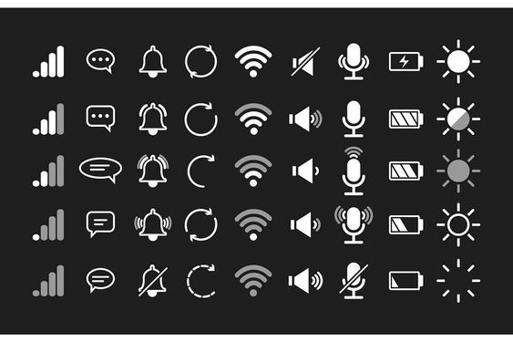
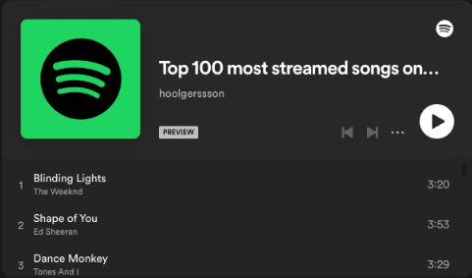
The goals
What properties does a hit song have?
audio footprint: danceability, energy, tempo, loudness, liveness…
How hit song features have changed over time? (from decembre 2016)
Check features of top 100 songs published each year
https://charts.spotify.com/charts/overview/global
What will be the new trends for the upcoming decade?
Predict important features that are becoming predominant
Can I create the next hit based on the 100 most streamed Spotify songs ever?
If possible, produce a sample of music that has all best features to be the next hit

Slide 5
The idea
From existing data :
Songs from the 1960s-2020s accessible from official Spotify’s API
Classify the 100 most streamed tracks on Spotify
Extract properties and tracks structures (audio footprint)
Goals:
Predict whether a given song will be a hit or not
Predict how hit songs will sound like in the future
Create a new song that should become a new hit based on audio analysis features

Slide 6
The model
Data available from Spotify’s API: https://developer.spotify.com/documentation/web-api/
Spotipy: Spotify Python Library https://spotipy.readthedocs.io/en/2.22.1/
Preprocessing: missing values, drop columns, encoding and scaling
Training: Try several classification models* to make our prediction
Validation: on existing songs released after 2022 (New released from 2023)
Predictions:
Trends for upcoming hit songs
on a non existing song
Audio analysis : Spotify audio analyser tool https://developer.spotify.com/documentation/web-api/reference/#/operations/get-audio-analysis
* for example: Logistic Regression, K-Nearest Neighbors, Decision Tree, Support Vector Machine (Linear Kernel), Support Vector Machine (RBF Kernel) , Neural Network, Random Forest, Gradient Boosting

Slide 7
Demo Day
Showing a demo app (Streamlit app for audio features and prediction of popularity)
Testing the model on few songs (not part of the training set) and check if the model predicted right
If possible, listen to the ideal computed song that should be a next biggest hit track on Spotify

Slide 8
hit predictor
Let’s get rich!
Any questions?

